Slide 1

Team Leadership “Must be able to build cohesive and productive work and project teams in order to achieve the required outputs, either as a work unit or as a component within the organization..”
Sanjeeva Perera
Senior Academic Fellow - Faculty of Computing

Slide 2
Attendance

Slide 3
Agenda
What is leadership?
Identify the traits and skills of an effective leader
Key leadership theories
Examine the role, duties and responsibilities of a Team Leader
Understand the limits of authority in a Team Leader role
Develop a plan to develop your own leadership potential
Most parts of this lecture is taken from University of Exeter, UK – Leadership Skills module

Slide 4
What is Leadership?
"Leadership is a function of knowing yourself, having a vision that is well communicated, building trust among colleagues, and taking effective action to realize your own leadership potential."
Prof. Warren Bennis

Slide 5

Definition of leadership there is still considerable controversy.
According to leadership guru Warren Bennis
“The End of Leadership” – Leadership cannot exist without the full inclusion, initiatives, and the cooperation of employees.
(one cannot be a great leader without great followers)

Slide 6
Why Controversy ? Leadership depend on many factors. For example, business environment. Cool and calm business environment vs. Highly volatile environment Captain of a Ship vs. Rafting on white water

Slide 7
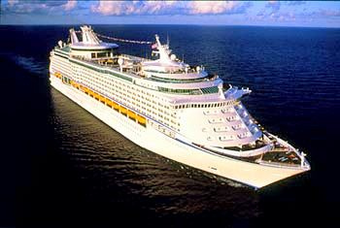
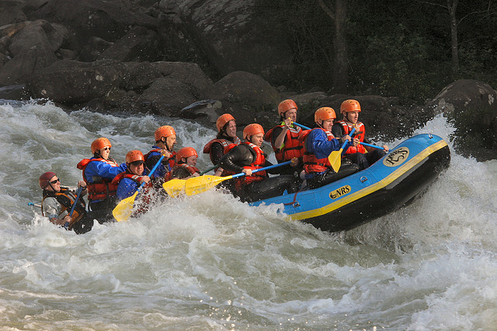
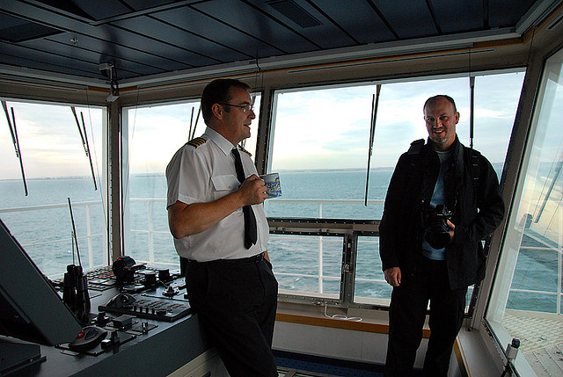
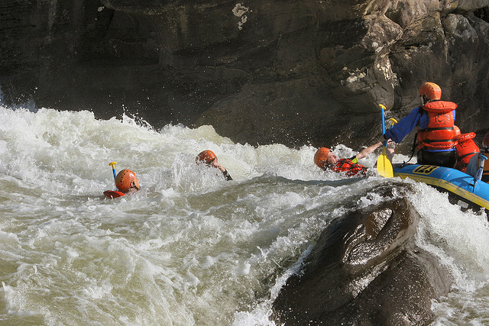
Captain of a ship vs Rafting on white water

Slide 8
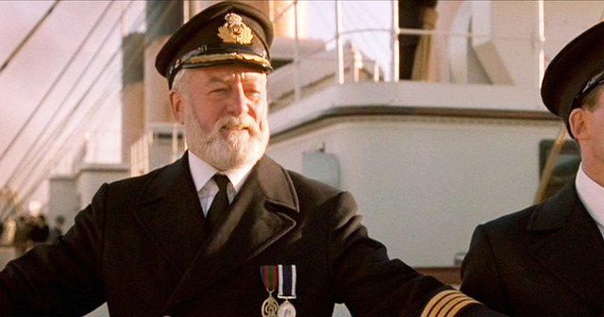
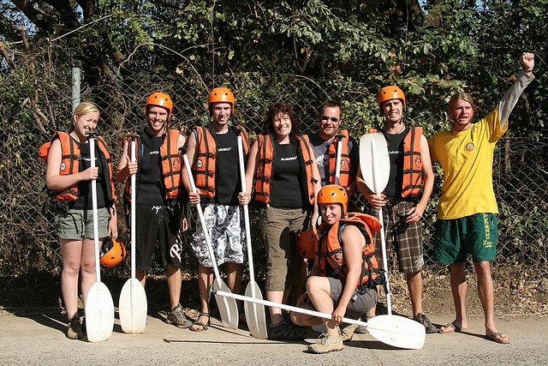
Cool and calm business environment vs. Highly volatile environment
Captain of a ship vs Rafting on white water

Slide 9
Leadership Theories and Models

Slide 10
Leadership Perspectives
1- Trait
Perspective
Leadership
Perspectives
2-Behavior
Perspective
4-Transformational
Perspective
3-Contingency
Perspective

Slide 11
Leadership Perspectives
1-Trait
Perspective

Slide 12
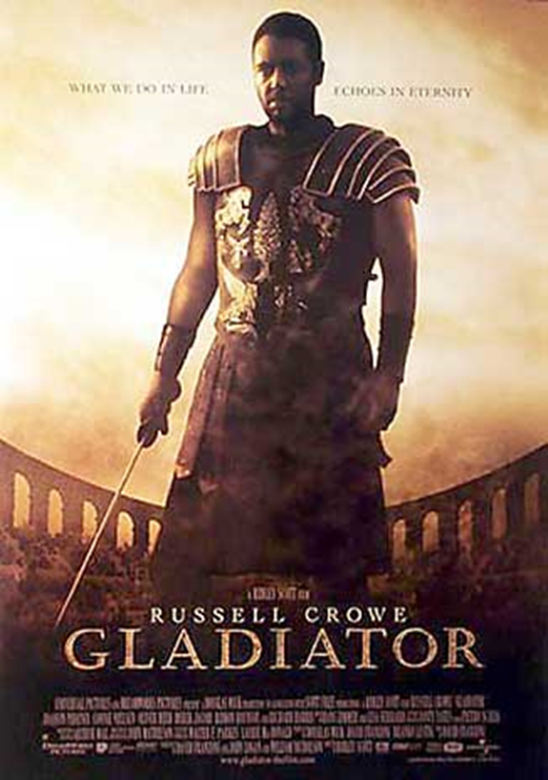
Leadership Theories
Early Theories:
Great Man Theories
Leaders are exceptional people, born with innate qualities, destined to lead
Term 'man' was intentional - concept was primarily male, military and Western

Slide 13
Leadership Theories
Early Theories:
Trait Theories
Research on traits or qualities associated with leadership are numerous
Traits are hard to measure. For example, how do we measure honesty or integrity?

Slide 14
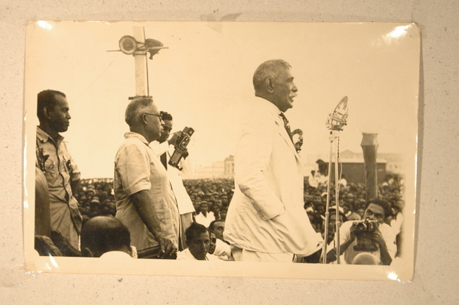
Trait Theories Don Stephen Senanayake was the first Prime Minister of Sri Lanka having emerged as the leader of the Sri Lankan independence movement that led to the establishment of self-rule in Sri Lanka. He is considered as the "Father of the Nation"

Slide 15
Leadership Traits and Skills
Traits
Adaptable to situations
Alert to social environment
Ambitious and achievement orientated
Assertive
Cooperative
Decisive
Dependable
Dominant (desire to influence others)
Energetic (high activity level)
Persistent
Self-confident
Tolerant of stress
Willing to assume responsibility
Skills
Clever (intelligent)
Conceptually skilled
Creative
Diplomatic and tactful
Fluent in speaking
Knowledgeable about group task
Organised (administrative ability)
Persuasive
Socially skilled
Stogdill, 1974
Leaders will also use:
Integrity, Honesty, Compassion, Humility

Slide 16
Leadership Theories
Functional Theories (John Adair, Action Centred Leadership, 1970)
Leader is concerned with the interaction of 3 areas:
Task – goal setting, methods and process
Team – effective interaction/communication, clarify roles, team morale
Individual – attention to behaviour, feelings, coaching, CPD

Slide 17
Leadership is situational
Action-Centred Leadership
Achieve task
Build team
Develop
individuals
John Adair

Slide 18
Action-Centred Leadership
Allocating resources
Organising duties and responsibilities
Focusing on goals
Planning work
Controlling quality
Checking performance
Reviewing progress
Achieve task

Slide 19
Action-Centred Leadership
Maintaining morale and building team spirit
Build team
Maintaining communication within the group
Setting standards and maintaining discipline
Ensuring systems support the work of the team

Slide 20
Action-Centred Leadership
Meeting the needs of individual
Attending to personal problems
Develop Individuals
Developing and training the individual
Giving praise and recognition

Slide 21
Leadership Perspectives
2-Behavior
Perspective

Slide 22
Leadership Theories
Behaviourist Theories (Blake and Mouton, Managerial grid, 1964)
Leaders' behaviour and actions, rather than their traits and skills e.g. production orientated, or people orientated
Different leadership behaviours categorised as ‘leadership styles’ e.g. autocratic, persuasive, consultative, democratic
Doesn’t provide guide to effective leadership in different situations

Slide 23
The Historically Important Studies on Leadership
The Iowa Leadership Studies (1930 by Lippitt and Ralph White)
Autocratic vs. Democratic vs. Laissez-Faire
The Ohio State Leadership Studies
Initiating Structure vs. Consideration
The Early Michigan Leadership Studies- human relations approach (1950s by university of Michigan)
Production Oriented vs. Employee Oriented

Slide 24
The Iowa Leadership Studies Autocratic vs. Democratic vs. Laissez-Faire
The question was whether a democratic style of leadership is more effective than an authoritarian or laissez-faire style. Study was done using 10-year old boys who were assigned to one of three after school hobby groups:
Democratic-
Allowed the group to decide who was to perform what task, pick their own partners, offer feedback
Authoritarian-
Assigned work partners, subjective with praise, decided what was to be done without boys feedback
Laissez-Faire Style-
Gave the group complete freedom, do whatever they wanted, provided information only when asked

Slide 25
The Iowa Leadership Studies Autocratic vs. Democratic vs. Laissez-Faire
In the study, which style do you think led to greater satisfaction?
Boys subjected to the autocratic leaders reacted in one of the two ways: either aggressively or apathetically. Both deemed to be reaction to the frustration. The researchers also pointed out that the apathetic groups exhibited outbursts of aggression when the autocratic leader left the room.
The laissez-faire leadership climate actually produced the greatest number of aggressive acts from the group.
The democratically led group fell between the one extremely aggressive group and the four apathetic groups under the autocratic leader.

Slide 26
The Ohio State Leadership Studies Initiating Structure vs. Consideration
This study looked at two independent dimensions of leadership:
Consideration –
Relies on mutual trust, respect for subordinates, and sensitivity to subordinate’s feelings.
Initiating Structure-
When a leader defines and structures the work that subordinates perform, working toward
successful completion.
Therefore a manager can be:
Highly considerate of subordinates, while lacking a concern for employee production.
May lack concern for employee feelings but is moderately concerned with unit output.
Devoted to both maximizing production (initiating structure) and employee well-being (consideration).
(This is the ideal style…combines the best of both dimensions)

Slide 27
The Early Michigan Leadership Studies- human relations approach Production Oriented vs. Employee Oriented
Studies conducted by Michigan University beginning in the 1950s
Found 3 critical characteristics of effective leaders:
Task-oriented behavior
Effective Leaders didn’t do the same work as their subordinates.
Relationship-oriented behavior
Focus on task, but also on relationship with subordinates
Participative leadership
Use a participative style, managing at the group level as well as individually
The role of the manager is more facilitative than directive

Slide 28
Leadership Perspectives
3-Contingency
Perspective

Slide 29
Hersey and Blanchard’s Situational Leadership Theory
Situational Leadership Theory (SLT)
A contingency theory that focuses on followers’ readiness.
Unable and Unwilling
Unable but Willing
Able and Unwilling
Able and Willing
Follower readiness: ability and willingness
Directive
High Task and Relationship Orientations
Supportive Participative
Monitoring
Leader: decreasing need for support and supervision

Slide 30
Leadership Theories
Situational/contingency Leadership (Hersey-Blanchard, 1970/80) Leadership style changes according to the 'situation‘ and in response to the individuals being managed – their competency and motivation
Competency | Low competence | Some competence | High competence | High competence
Motivation | Low commitment/ Unable and unwilling or insecure | Variable commitment/ Unable but willing or motivated | Variable commitment/ Able but unwilling or insecure | High commitment/ Able and willing or motivated
Leadership style | DIRECTIVE (Telling) | COACHING (Selling) | SUPPORTIVE (Participating) | DELEGATORY (Observing)

Slide 31
Leadership Styles and Follower Readiness (Hersey and Blanchard)
Follower Readiness
Unwilling
Willing
Able
Supportive Participative
Monitoring
Leadership Styles
High Task and Relationship Orientations
Unable
Directive

Slide 32
Leadership Perspectives
4-Transformational
Perspective

Slide 33
Leadership Theories
Transformational Theory (Bass and Avolio, 1994)
Leaders inspire individuals, develop trust, and encourage creativity and personal growth
Individuals develop a sense of purpose to benefit the group, organisation or society. This goes beyond their own self-interests and an exchange of rewards or recognition for effort or loyalty.

Slide 34
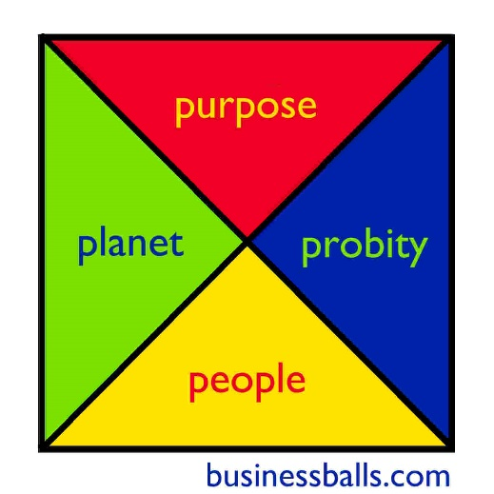
Leadership Theories
Ethical Leadership (Alan Chapman, 2006)
Four P’s - Purpose, People, Planet, Probity
CSR, sustainability, equality, humanitarianism
Probity: the quality of having strong moral principles; honesty and decency:

Slide 35
Key Team Leader Responsibilities
Guide/coordinate team members – encourage teamwork and motivate individuals
Provide structure for team – set mission and purpose, clarify roles and responsibilities, allocate tasks and set objectives
Clarify working methods, practises and protocol
Focus on performance – anticipate challenges, monitor performance, delegate and provide CPD support

Slide 36
Accountability, Responsibility, and Authority
Accountability the state of being accountable, liable, or answerable
Responsibility (for objects, tasks or people) can be delegated but accountability cannot – buck stops with you!
A good leader accepts ultimate responsibility:
will give credit to others when delegated responsibilities succeed
will accept blame when delegated responsibilities fail
Accountability can not operate fairly without the leader being given full authority for the responsibilities concerned
Authority is the power to influence or command thought, opinion or behaviour
Cross-functional team – less authority - more difficult to manage

Slide 37
How to improve your leadership skills
Reflect and identify the skills YOU need to lead effectively and create your action plan to develop them
Ask for feedback from work colleagues, line managers, tutors, your ‘followers’
Practise! Take on responsibility (work, volunteering, clubs & Societies) and reflect on your performance
Find a mentor – learn from positive leadership role-models
Attend further leadership and management training

Slide 38
Review your performance as a leader
Exercise:
Assess yourself as a Leader
Conduct a SWOT analysis - Strengths, Weaknesses, Opportunities, Threats
Develop an Action Plan to improve as a leader
list 2 actions you will undertake to address Weaknesses or capitalise on Opportunities identified
Apply SMART targets to your actions – Specific,
Measurable, Achievable, Realistic, Time-bound
3. Write a reflective journal about one of the Leadership experiences you faced with a team or in your life

Slide 39
Questions ?

